Slide 1
Grant Management
Grant Documents That Read Like a Novel
Dawn Jenkins, Senior Budget Analyst, City of Peoria
Mindy Russell, Budget Management Assistant, City of Peoria
GFOAz Training – May 9, 2019
Notes:
.

Slide 2
We were awarded a Grant!
BIG SMILE
Happy Dance!!
Funds are coming
$ Money$$Money$
Notes:
Now the fun begins
But wait….
Who got the movie
Who got the popcorn
Who got the soda
Who got the snacks
Most important…
Who got the chocolate

Slide 3

The Grant Document Novel Begins:
Grant Team Meeting
  Key personnel who should attend the meeting
      Grant Manager
      Project Manager
        This may or may not necessarily be the Grant Manager
      Finance
      Procurement/Materials Management
    Keep in mind, one attendee may
    have multiple roles
Notes:
Key personnel that should attend the meeting
Grant Manager
Project Manager
This may or may not necessarily be the Grant Manager
Finance and Budget
Grant Coordinator
Keep in mind, one attendee may
have multiple roles

Slide 4
Grant Team Meeting
  Read and understand Grant award documents
    Contract consists of
      Contract Number
      Contract Dates
      Awarding Agency and their point of contact
      Award Notification (Amount awarded and Match)
      Grantee point of contact/project manager
      Scope of Work
        Program reporting may be required
        Keep a log of job progression
Notes:
Read and understand Grant award documents
Contract consists of
Contract Number
also referenced as Award/Agreement/Grant Number /CFDA Number if Federal Grant or pass thru
Contract Dates
These dates are important to ensure proper reporting and close out and use of funds in the time allotted by the contract dates
Awarding Agency and their point of contact
More than likely who you will contact for any question pertaining to the grant; Federal or pass thru
Award Notification (Amount awarded and Match)
Understand how the proportionate shares breakdown
Grantee point of contact/project manager
Verify this is still the same person at the time of grant application and probably should assign a backup to this individual
Scope of Work
Program reporting may be required
Keep a log of job progression

Slide 5

Grant Team Meeting
  Read and understand Grant award documents
    Contract consists of (continued)
      RFP or NOFA (state or federal rules)
        What can you purchase?
      Payment Method
        Reimbursement/Advance
        Wire/Check
      Reporting: Financial and Program
        Monthly, Quarterly, etc.
        Are there multiple agencies requiring reporting?
Notes:
Read and understand Grant award documents
Contract consists of (continued)
RFP or NOFA (state or federal rules) NOFA = Notice of Funds Available
What can you purchase?
Make sure there is sufficient supporting documentation
Does the grant cover indirect costs
Payroll… usually needs to be re-classed to the grant fund
Payment Method
Reimbursement/Advance
Wire/Check
Reporting: Financial and Program
Monthly, Quarterly, etc.
Is there multiple agencies requiring reporting

Slide 6
Grant Team Meeting
  Read and understand Grant award documents
    Contract consists of (continued)
      Equipment Requirements
      Audit Requirements
        Establish and Maintain Effective Internal Controls
      Document Retention
        Arizona State Library, Archives and Public Records
      Multiple Grants for one department (example: Police)
        Track expenditures to avoid double reimbursement by more than one grant

Slide 7
Grant Team Meeting
  Assign roles and responsibilities
    Grant Manager
      Holder of “Grant Document Novel”
      Consultant
    Project management
      Probably an assigned department employee
      Holder of the “Grant Document Novel”

Slide 8
Grant team Meeting
  Assign roles and responsibilities (continued)
    Financials
      Establish Budget Authority
      Procurement Approvals
        Verify understanding of contract requirements
      Finance Liaison

Slide 9
Grant team Meeting
  Assign roles and responsibilities (continued)
    Reporting – Program and Financials
      Monthly, Quarterly, Annually, Project Close-out
      Compiled by
        Program – usually department
        Financial – usually department and verified/approved by finance liaison
    Payments – who requests, who approves?
      Financial reports documentation for backup
      Key players that need notification of payment

Slide 10
Grant File
Where is it stored?
  Computer (who has access?)
  Notebook
  How long do you need to keep the file?

Slide 11
What is in the grant file?
  Contact information for everyone
    Grantor and Grantee
  Contracts/NOFA/RFP/Award Letter
  Amendments

Slide 12
What else is in the grant file?
  Correspondence (emails, letters, Phone logs notes)
    Approval for project or funding changes
  Project photos
  Equipment photos and identification numbers and locations.

Slide 13
What else is in the grant file?
  Financial records
    Invoices, copies of checks, any correspondence approving changes to the budget
  Reports (monthly, quarterly, annual, final)
    Program/Project
    Financial
    Hint: The grant file should tell the
    entire grant project story

Slide 14
My grant project has been
successfully completed!!
Congratulations!

Slide 15

My grant project is being
AUDITED

Slide 16
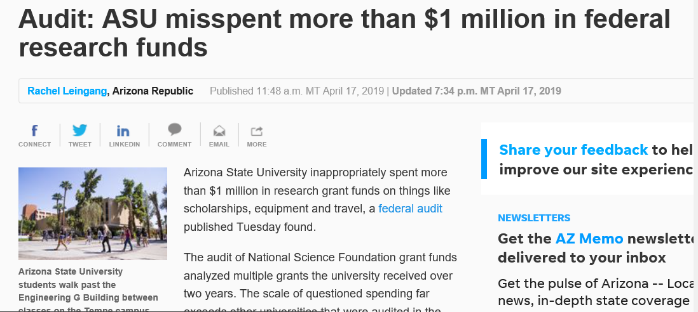
OOPS…

Slide 17

My grant file is in order!
The audit was a success!

Slide 18

Questions?

Slide 19


